Slide 1
Introduction to Programming
Welcome to
Bowu Zhang
Department of Computer Science
Marist College

Slide 2
Contact
Bowu Zhang
B.S in Electrical Engineering,
Univ. of Sci. & Tech. of China,
China
Ph.D in Computer Science,
George Washington University, Washington, D.C., US
Personal Website:
  under construction
Research Interests
  Networking
  Machine Learning
  Mobile Health
Contact Information
  Office: Hancock 3014
  Office Hours:
  Monday: 3:30 p.m. to 5 p.m.
  Tuesday: 12 p.m. to 2 p.m.
  Friday: 2 p.m. to 4 p.m.
  Email: bowu.zhang@marist.edu

Slide 3
What is this class?
A broad introduction to computers, the Internet, information representation, and the art of computer programming.
  HyperText Markup Language (HTML)
  Cascading Style Sheets (CSS)
  JavaScript

Slide 4
Course Information
The class webpage:
iLearn (https://ilearn.marist.edu)
  CMPT 120L114
No paper handout
All slides, assignments and solutions will be updated on iLearn (https://ilearn.marist.edu)

Slide 5
Textbook
Required:
Internet and WWW How to Program
5th edition, by Dietel, Dietel, & Dietel, ISBN 978‐0132151009

Slide 6
Course Procedures
Two lectures every week
  Mondays, 2:00 pm - 3:15 pm, Hancock 0004
  Thursdays, 2:00 pm - 3:15 pm, Hancock 2020
  Slides and demonstrations, and hands-on exercises
A lab every week
  Mondays, 9:30 am - 10:45 am, Hancock 0005
  Programming exercises

Slide 7
Course Work
Lab Assignments: 25%
Final Project: 15%
In-class Exercises: 10%
Quizzes: 10%
Midterm Exam: 20% -- cheat sheet allowed
Final Exam: 20% -- cheat sheet allowed

Slide 8
Lab Assignments
A lab every week
  You need to show your instructor what you have done before the lab ends, in order to receive full credit.
  A lab report is required for every lab, and must be uploaded to iLearn before due date.
  For each lab, lab attendance and your work during lab 40%, lab report 60%.
  For each day your report is late, 10% will be deducted from your score; reports will NOT be accepted after one week.

Slide 9
Final Project
One final project (Individual project)
  Weekly reports
  Oral presentation
  A final report

Slide 10
In-class Exercises
Hands-on exercises every lecture
  You need to show results to the instructor before you leave the classroom

Slide 11
Quizzes
A number of quizzes
  related to the lecture
  time will be notified in advance
  (usually) at the beginning of the class

Slide 12
Exams
Two Written Exams (Midterm, Final)
  Individual, written exams
  Cheat sheet allowed

Slide 13
Collaboration
You are encouraged to form study groups and to discuss the course material with your classmates.
Do not, under any circumstances, copy another person's program.

Slide 14
How to Do Well in This Class?
Keep up with the exercises/assignments/quizzes
  The course material is cumulative
  Start early!
If you don’t understand something, ask questions (especially “WHY?”)
  Computers are neither magical nor mysterious.
  Everything can be explained!

Slide 15
Course Overview

Slide 16
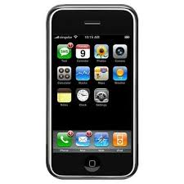

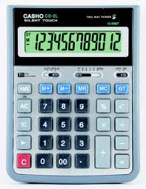
What is a Computer?
A computer takes an input, applies a process, and produces an output.

Slide 17
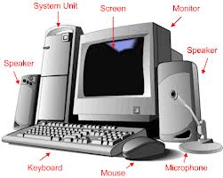
Hardware
Physical parts or components of a computer

Slide 18

Software
Machine-readable instructions that directs a computer's processor to perform specific operations.

Slide 19

What is a Program?
A set of instructions written in a computer language to be carried out by a computer.
Software is made up of programs.

Slide 20
What is the Internet?
Wikipedia: http://en.wikipedia.org/wiki/Internet
  A connection of computer networks using the Internet Protocol (IP)
What's the difference between the Internet and the World Wide Web (WWW)?
  The Web is the collection of web sites and pages around the world
  The Internet is larger and also includes other services such as email, chat, online games, etc.

Slide 21

Client-Server Model
request
response
Internet
Server
Client

Slide 22
Web Programming Topics
HTML = HyperText Markup Language: specify the structure/content of a web page.
CSS = Cascading Style Sheets: specify the appearance of a web page.
JavaScript (not Java): specify the behavior of a web page.
AND
Concepts and tools for graphics, sound, forms, animation, and movies.
Designing a website and implementing it using HTML, CSS, and JavaScript.

Slide 23
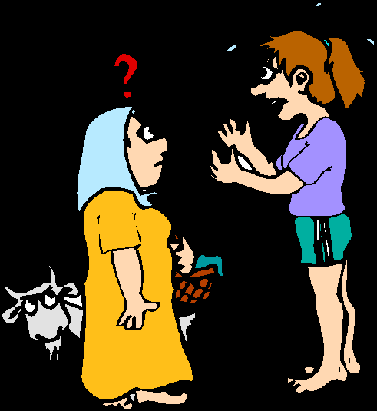

Why Programming Language?
Programs are written, or coded, in a programming language.
Programs are executed by CPU.

Slide 24
Machine Language
Binary code
Hard to read and write
Machine Code
01111010000101010100100011010001101000111110010101010010100110001010110001010000011101010101110001100110010000100110101010101001000011110001110000000111101000101010101010010001110…

Slide 25
Compiler
source
code
machine
code
compiler

Slide 26
Interpreter
machine
code
ready for execution
Interpreter

Slide 27
Build and Run Overview
Source Code
Compiler
Computer
Machine Code
Interpreter
Computer


Slide 28
In Our Class...
Source Code: written in HTML, CSS, and JavaScript
  *.html
  *.css
  *.js
Compiler and Interpreter: web browser
  Google Chrome
  Firefox
  IE
  ...

Slide 29
Example
Coffee
Quiz
Tic-Tac-Toe

Slide 30
Our First Program
Create and run helloworld.html
  Open and Size Notepad++ (Windows).
    Use Sublime Text 2 if you are using Mac
    Nodepad/Wordpad/TextEdit is also OK, but not recommended
  Type the following into Notepade++
<!DOCTYPE html>
<html>
<head>
<meta charset = "uft-8">
<title> Our First Webpage </title>
</head>
<body>
<p>Hello, world!</p>
</body>
</html>

Slide 31
Our First Program (cont.)
Then click on File – Save As. Save the file on the desktop with file name helloworld.html.
  make sure the extension is .html
Launch the helloworld html page in the browser.
  Google Chrome is the standard browser in this class.

Slide 32
Example
<!DOCTYPE html>
<html>
<head>
<meta charset = "uft-8">
<title> Our Second Webpage </title>
</head>
<body>
<p>Welcome to CMPT120!</p>
<p>This is our first class this semester.</p>
</body>
</html>

Slide 33
In-class Exercise
Make another html file that describes your name, major, and class year.
  name it yourname.html (replace "yourname" by your first name)
  view it in Google chrome

Slide 34
HTML

Slide 35
HTML
Hypertext Markup Language (HTML)
  describes the content and structure of information on a web page
    not the same as the presentation (appearance on screen)
  surrounds text content with opening and closing tags
  most whitespace is insignificant in HTML (ignored or collapsed to a single space)

Slide 36
Structure of a HTML page
<!DOCTYPE html>
<html>
  <head>
  information about the page
  </head>
  <body>
  page contents
  </body>
</html>

Slide 37
Tags
Keywords surrounded by angle brackets
  A tag is a tag-name enclosed in angle brackets, for example: <html>
  Tags come in pairs: an opening tag and a closing tag
<tag-name> content affected by tag </tag-name>
  <title> Our First Webpage </title>

Slide 38
Rules about Tags
Not all tags need closing tag
  For some tags, a closing tag is optional:
    <P> paragraph.
  For some tags (such as <br>, <hr>, and <img>) , a closing tag is never used:
    This text contains<br>a line break.
    Empty tags
Tag names are case-insensitive
  <br> and <BR> and <Br> are all equivalent

Slide 39
Elements
Everything from the opening tag to the closing tag
<p>This is a paragraph.</p>
opening tag:
<p>
Element content:
This is a paragraph.
closing tag:
</p>

Slide 40
Web Pages/HTML Documents
Web pages are plain text documents that contain HTML tags
HTML documents are Web pages
Recommended plain text editors:
  Sublime Text (Mac), Notepad++ (Windows)

Slide 41
Web Browsers
Reads HTML documents and displays them as Web pages
Web browsers do not display HTML tags, but use them to interpret the content of the page
This is also where most of our programs will be executed

Slide 42
Tags for Document Structure

Slide 43
Structure Tags
Some tags specify the overall structure of the document
<html> ... </html> encloses the entire document
<head> ... </head> encloses the head portion of the document. Everything in the head portion is meta-information, not content.
<body> ... </body> encloses the body portion of the document. The body portion contains the document's content.

Slide 44
Reivew: Structure of an HTML page
<!DOCTYPE html>
<html>
  <head>
  information about the page
  </head>
  <body>
  page contents
  </body>
</html>

Slide 45
Tags for Document Head

Slide 46
Page title: <title>
Describes the title of the web page
Placed within the head of the page
Displayed in the web browser's title bar and when bookmarking the page
    <title>Chapter 2: HTML Basics</title>
Other head tags will be discussed later.

Slide 47
Tags for Document Body

Slide 48
Headings: <h1>, <h2>, ..., <h6>
Headings to separate major areas of the page (block)
  <h1>University of Whoville</h1>
  <h2>Department of Computer Science</h2>
  <h3>Sponsored by Micro$oft</h3>
More Heading examples
  http://www.w3schools.com/tags/tryit.asp?filename=tryhtml_headers

Slide 49
Style: <b>, <u>, <strong>,...
Explicit style tags
  <b>Boldfaced text</b>
  <u>Underlined text</u>
Logical style tags
  <strong>Prominent text</strong> - usually bold
  <em>Emphasized text</em> - usually italics

Slide 50
Organization: <p>, <br>, <blockquote>, ...
Paragraphs and Layout
  <p> - start of a new paragraph.
    The closing </p> tag is optional but recommended, especially if the tag contains attributes.
  <br> - line break.
    Use this where the extra line spacing of a paragraph tag is not desirable, as in an address.
    Never takes a closing tag.
  <blockquote>Quoted text</blockquote>
    for large blocks of quoted material.

Slide 51
Example
<p>Teddy said it was a hat, <br> So I put it on.</p>
<p>Now Daddy's sayin', <br> Where the
heck's the toilet plunger gone?</p>
<p>
HTML is <em>really</em>,
<strong>REALLY</strong> fun!
</p>

Slide 52
To Do List
Make sure you read the to-do list on iLearn.

